Slide 1
Learning Objective
I will be able to apply the 68-95-99.7% rule
Success Criteria
At the end of the lesson, I will be able to:
4.2.5 identify contexts, such as naturally occurring variation, that are suitable for modelling by normal random variables
4.2.6 identify features of the graph of the probability density function of the normal distribution with mean μ and standard deviation σ and the use of the standard normal distribution
4.2.7 calculate probabilities and quantiles associated with a given normal distribution using technology, and use these to solve practical problems

Slide 2
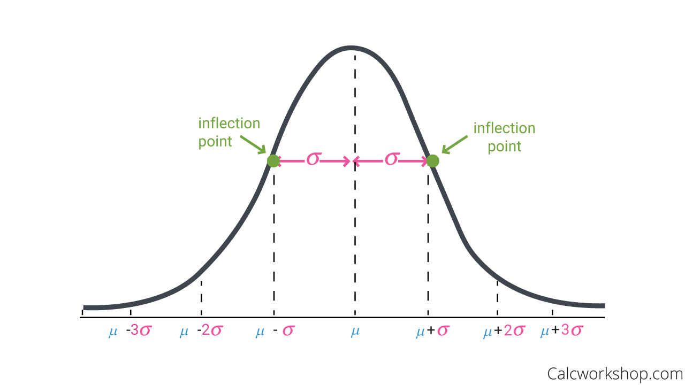
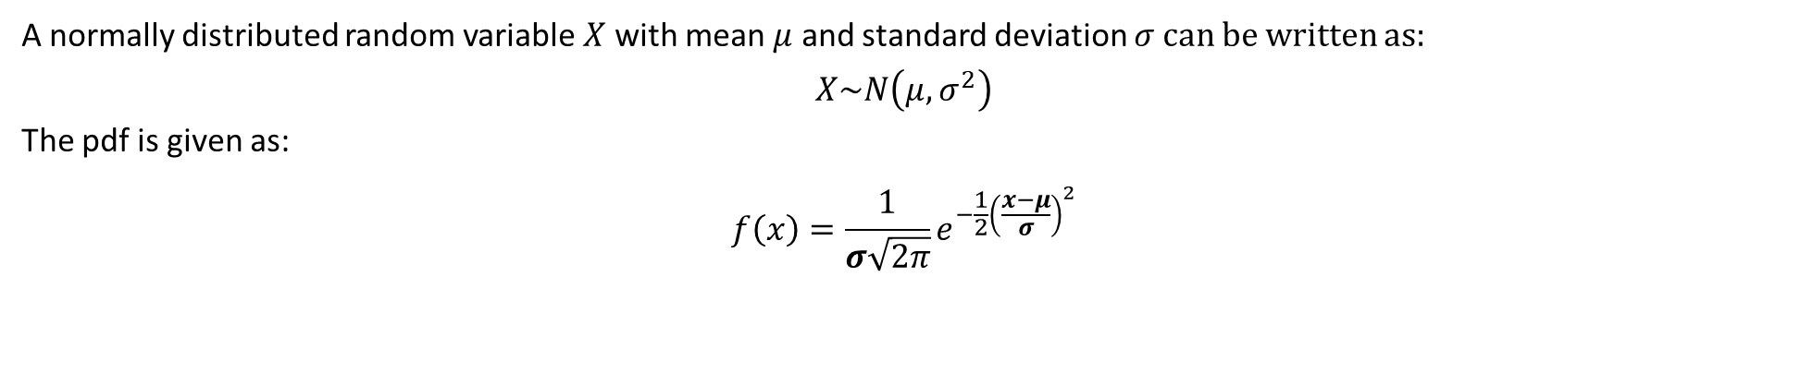
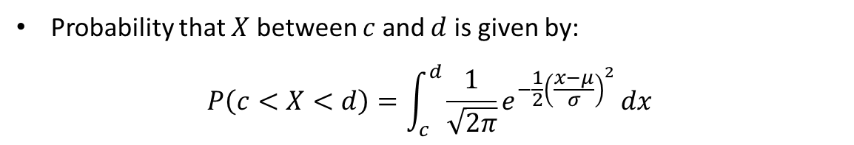
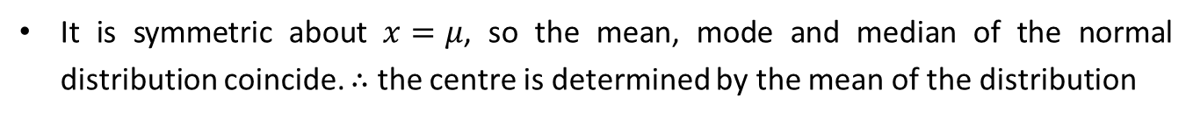
Recap: The General Normal Distribution
A normally distributed random variable $X$ with mean $μ$ and standard deviation $σ$can be written as:
$$X\sim N\left(μ, σ^{2}\right)$$
The pdf is given as:
$$f\left(x\right)=\frac{1}{σ\sqrt{2π}}e^{−\frac{1}{2}{\left(\frac{x−μ}{σ}\right)}^{2}}$$
Properties of a Normal Distribution
The graph of a normal distribution is symmetric and bell-shaped
It has an asymptote of $y=0$
It is symmetric about $x=μ$, so the mean, mode and median of the normal distribution coincide. $∴$ the centre is determined by the mean of the distribution
The width is determined by the standard deviation. The points of inflection of the curve are located one SD on either side of the mean.
The larger the value of the SD, the greater the spread of the curve.
Total area under the curve is unity, that is 1.
Probability that $X$ between $c$ and $d$ is given by:
$$P\left(c<X<d\right)=\int_{c}^{d}{\frac{1}{\sqrt{2π}}e^{−\frac{1}{2}{\left(\frac{x−μ}{σ}\right)}^{2}}}dx$$

Slide 3
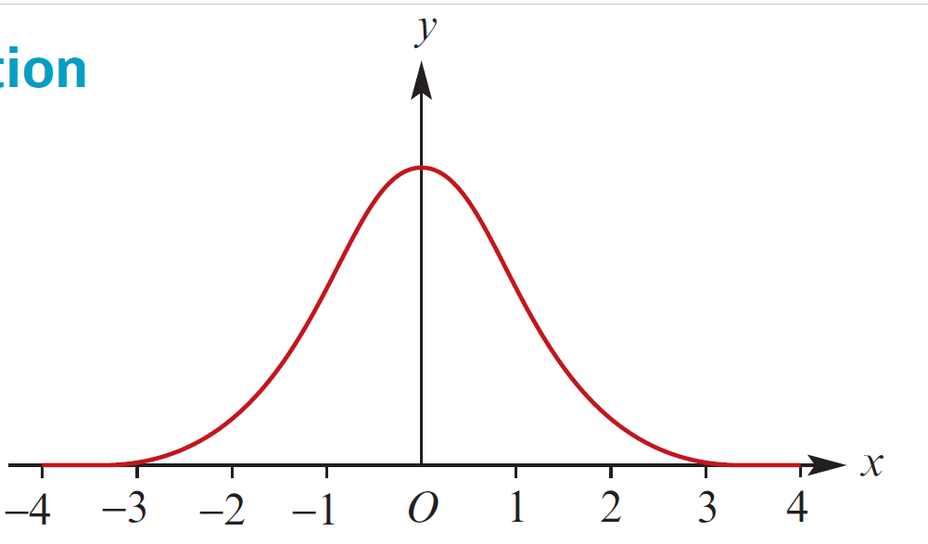
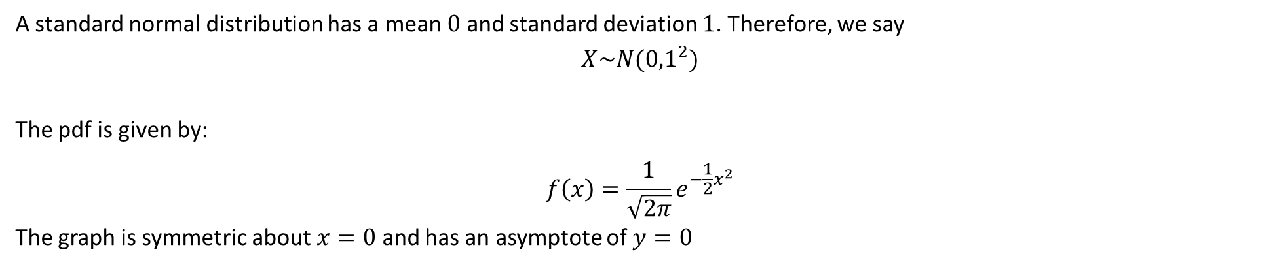
Recap: The Standard Normal Distribution
A standard normal distribution has a mean $0$ and standard deviation $1$. Therefore, we say
$$X\sim N({0,1}^{2})$$
The pdf is given by:
$$f\left(x\right)=\frac{1}{\sqrt{2π}}e^{−\frac{1}{2}x^{2}}$$
The graph is symmetric about $x=0$ and has an asymptote of $y=0$

Slide 4
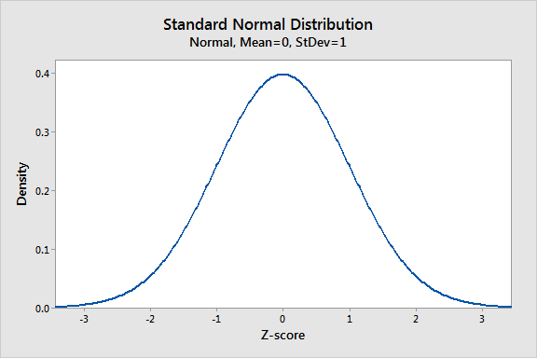
The Standard Normal Distribution, and Standard Scores
Not all datasets come from the same population. Take for example, your Mathematics test results. How could we tell if you are improving from one test compared to another we have:
Different topics
Different number of marks
Different levels of difficulty?
The diagram to the right shows is
the standard normal distribution, which
specifically has a mean of 0 and a standard
deviation of 1. These parameters allow us to
make comparisons across different populations
but before that, we must convert our scores
into standard scores, or z-scores.

Slide 5
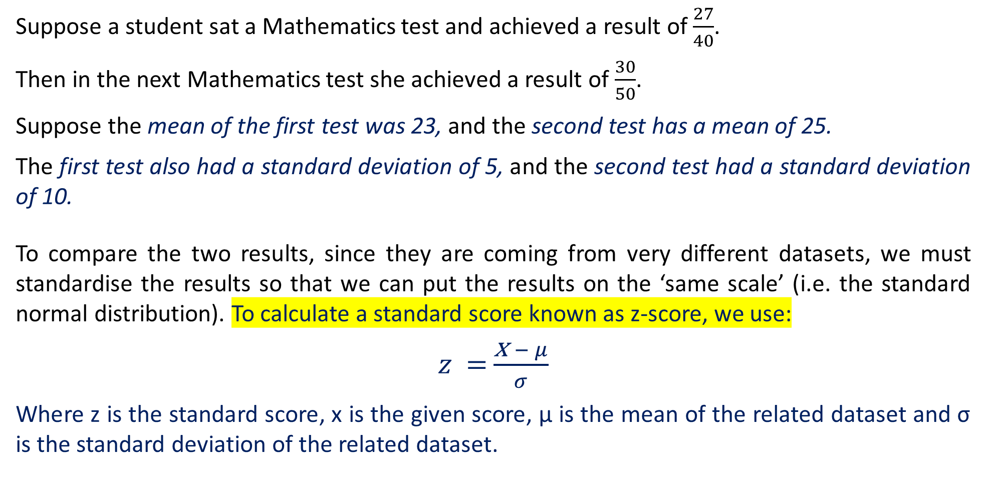
Standard Scores, or z-scores
Suppose a student sat a Mathematics test and achieved a result of $\frac{27}{40}$.
Then in the next Mathematics test she achieved a result of $\frac{30}{50}$.
Suppose the mean of the first test was 23, and the second test has a mean of 25.
The first test also had a standard deviation of 5, and the second test had a standard deviation of 10.
To compare the two results, since they are coming from very different datasets, we must standardise the results so that we can put the results on the ‘same scale’ (i.e. the standard normal distribution). To calculate a standard score known as z-score, we use:
$z =$ $\frac{\text{x} − μ}{σ}$
Where z is the standard score, x is the given score, μ is the mean of the related dataset and σ is the standard deviation of the related dataset.

Slide 6
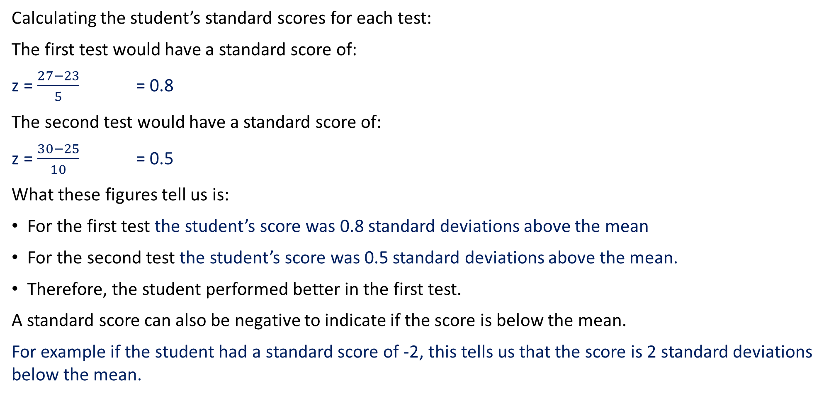
Standard Scores, or z-scores
Calculating the student’s standard scores for each test:
The first test would have a standard score of:
z = $\frac{27−23}{5}$ = 0.8
The second test would have a standard score of:
z = $\frac{30−25}{10}$ = 0.5
What these figures tell us is:
For the first test the student’s score was 0.8 standard deviations above the mean
For the second test the student’s score was 0.5 standard deviations above the mean.
Therefore, the student performed better in the first test.
A standard score can also be negative to indicate if the score is below the mean.
For example if the student had a standard score of -2, this tells us that the score is 2 standard deviations below the mean.

Slide 7
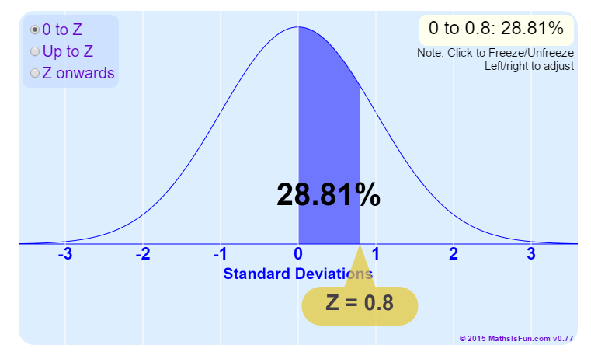
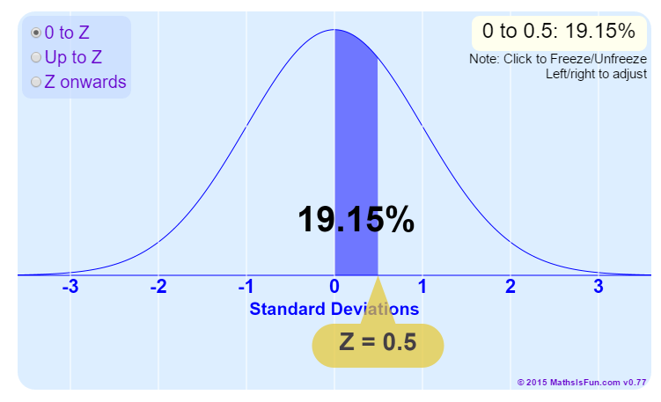
Standard Scores, or z-scores
On the standard normal distribution, this is where the student’s z-scores of 0.8 and 0.5 would lie:
Hence the student did not improve with their second test. Additionally, we calculate the proportion of marks that were below the student’s results using technology. The student did better than 69.15% of the rest of the class in the second test, while they did better than 78.81% of the class in the first test.

Slide 8
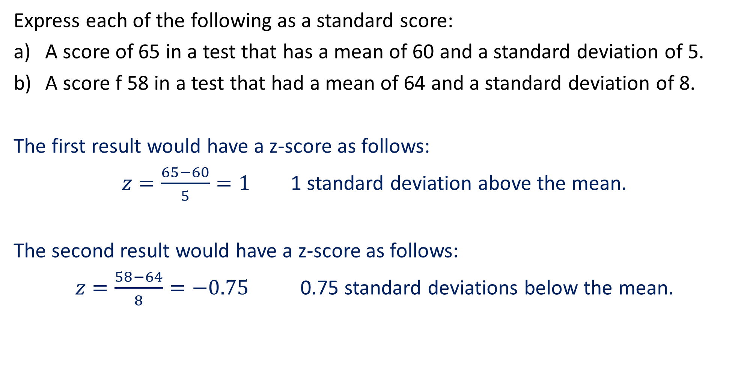
Guided Practice
Express each of the following as a standard score:
A score of 65 in a test that has a mean of 60 and a standard deviation of 5.
A score f 58 in a test that had a mean of 64 and a standard deviation of 8.
The first result would have a z-score as follows:
$z=\frac{65−60}{5}=1$ 1 standard deviation above the mean.
The second result would have a z-score as follows:
$z=\frac{58−64}{8}=−0.75$ 0.75 standard deviations below the mean.

Slide 9
Guided Practice
All Year 10 students in a particular region sat exams in Mathematics, English, Science and Social Studies. The exam results in these subjects produced the following means and standard deviations.
Mathematics MEAN: 63 STANDARD DEVIATION: 14
English MEAN: 64 STANDARD DEVIATION: 10
Science MEAN: 72 STANDARD DEVIATION: 8
Social Studies MEAN: 106 STANDARD DEVIATION: 22
One student achieved the following scores:
76 for Maths, 75 for English, 78 in Science, 104 in Social Studies
Rank the four subjects in order for this student, highest standardised score first.
The z-scores of MATHS = 0.929 ENGLISH = 1.1 SCIENCE = 0.75 SOCIAL STUDIES = -0.091
Ranked in order of highest standard score first: English, Maths, Science, Social Studies

Slide 10
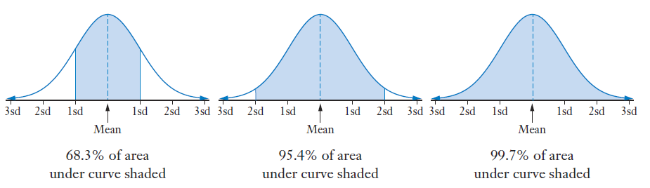
68%, 95%, 99.7% Rule
On a previous slide, we were able to determine the proportions of the population above or below the mean from the bell-curve. There is a ‘rule-of-thumb’ that the following statements are true:
Approximately 68% of a dataset that is normally distributed will lie within 1 standard deviation of the mean
Approximately 95% of a dataset that is normally distributed will lie within 2 standard deviations of the mean
Approximately 99.7% of a dataset that is normally distributed will lie within 3 standard deviations of the mean

Slide 11
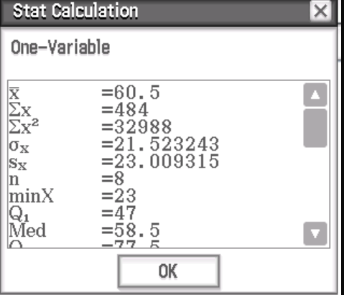
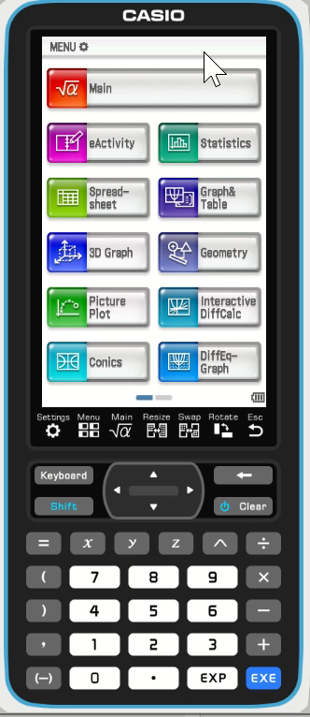
68%, 95%, 99.7% Rule
23, 46, 48, 50, 67, 75, 80, 95
Calculate the mean and standard deviation of this dataset.
The mean is 60.5
The standard deviation is 21.5
Remember that standard deviation measures the spread of data.
To find out how many scores lie within 1 standard deviation of the mean:
Mean + 1 Standard Deviation = 60.5 + 21.5 = 82
Mean – 1 Standard Deviation = 60.5 – 21.5 = 39
Scores within 1 standard deviation are between 39 and 82.
6 scores out of 8 are within this range. This is approximately 75% of the scores.

Slide 12
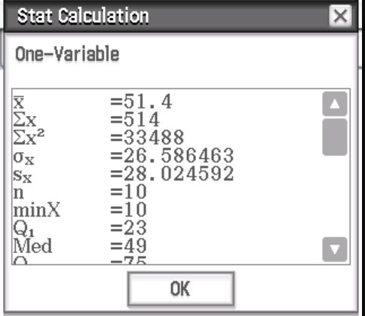
68%, 95%, 99.7% Rule
10, 20, 23, 46, 48, 50, 67, 75, 80, 95
Calculate the mean and standard deviation of this dataset.
The mean is 51.4
The standard deviation is 26.6
Calculate one standard deviation above and below the mean.
Mean + 1 Standard Deviation = 51.4 + 26.6 = 78
Mean – 1 Standard Deviation = 51.4 – 26.6 = 24.8
Scores within 1 standard deviation are between 24.8 and 78
5 scores out of 10 are within this range. This is approximately 50% of the scores.

Slide 13
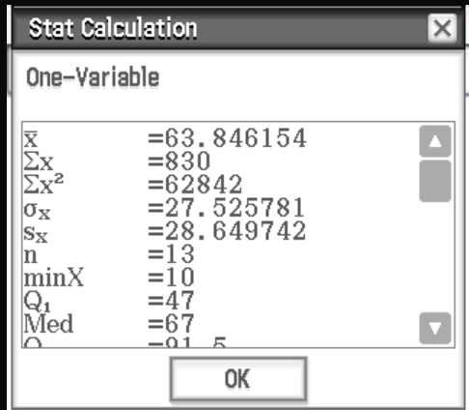
68%, 95%, 99.7% Rule
10, 23, 46, 48, 50, 51, 67, 75, 80, 88, 95, 97, 100
Calculate the mean and standard deviation of this dataset.
The mean is 63.8
The standard deviation is 27.5
Calculate one standard deviation above and below the mean.
Mean + 1 Standard Deviation = 63.8 + 27.5 = 91.3
Mean – 1 Standard Deviation = 63.8 – 27.5 = 36.3
Scores within 1 standard deviation are between 36.3 and 91.3
8 scores out of 13 are within this range. This is approximately 62% of the scores.

Slide 14
68%, 95%, 99.7% Rule
In the first dataset we had 75% of our data within 1 standard deviation of the mean.
In the second dataset we had 55% of our data within 1 standard deviation of the mean.
In the third dataset we had 62% of our data within 1 standard deviation of the mean.
If we continued this experiment several times with datasets of larger sample sizes, we would
find that approximately:
68% of the dataset lies within 1 standard deviation of the mean.
95% of the dataset lies within 2 standard deviations of the mean.
99.7% of the dataset lies within 3 standard deviations of the mean.

Slide 15
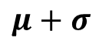
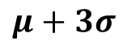
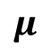
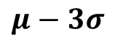
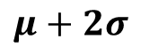
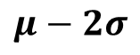
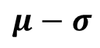
The Normal Distribution
The normal distribution has a bell
shaped, symmetrical curve.
We use the symbol μ for the mean
and the symbol σ for the standard
deviation.
$$μ−3σ$$
$$μ−2σ$$
$$μ−σ$$
$$μ$$
$$μ+σ$$
$$μ+2σ$$
$$μ+3σ$$

Slide 16
The Normal Distribution
If we take measurements of anything that occurs naturally, such as the heights of people, blood pressure or the weights of cats, we would find that the histogram of our dataset generally looks like a bell curve like the one below.
$$μ−3σ$$
$$μ−2σ$$
$$μ−σ$$
$$μ$$
$$μ+σ$$
$$μ+2σ$$
$$μ+3σ$$
In terms of probability, we can say that the probability a random selected individual from a normally distributed population being within:
One standard deviation is 0.68 or 68%
Two standard deviations is 0.95 or 95%
Three standard deviations is 0.997 or 99.7%

Slide 17
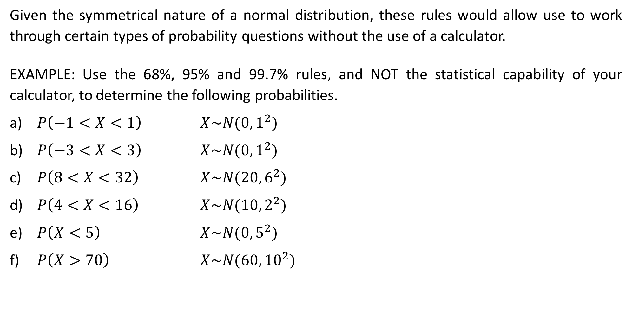
Guided Practice
Given the symmetrical nature of a normal distribution, these rules would allow use to work through certain types of probability questions without the use of a calculator.
EXAMPLE: Use the 68%, 95% and 99.7% rules, and NOT the statistical capability of your calculator, to determine the following probabilities.
$P\left(−1<X<1\right)$ $X\sim N(0, 1^{2})$
$P\left(−3<X<3\right)$ $X\sim N(0, 1^{2})$
$P\left(8<X<32\right)$ $X\sim N(20, 6^{2})$
$P\left(4<X<16\right)$ $X\sim N(10, 2^{2})$
$P\left(X<5\right)$ $X\sim N(0, 5^{2})$
$P\left(X>70\right)$ $X\sim N(60, {10}^{2})$

Slide 18
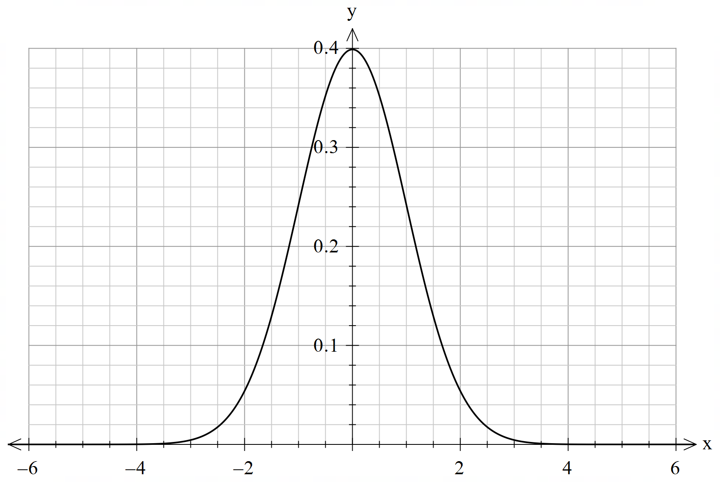
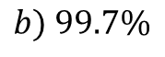
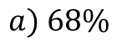
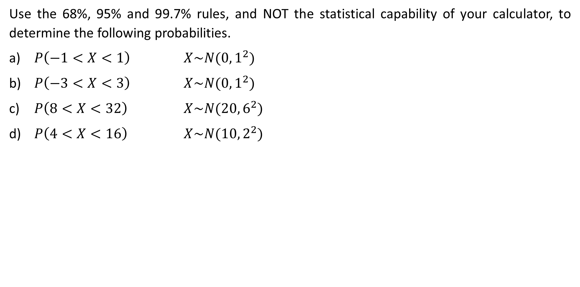
Guided Practice
Use the 68%, 95% and 99.7% rules, and NOT the statistical capability of your calculator, to determine the following probabilities.
$P\left(−1<X<1\right)$ $X\sim N(0, 1^{2})$
$P\left(−3<X<3\right)$ $X\sim N(0, 1^{2})$
$P\left(8<X<32\right)$ $X\sim N(20, 6^{2})$
$P\left(4<X<16\right)$ $X\sim N(10, 2^{2})$
$$a) 68\%$$
$$b) 99.7\%$$

Slide 19
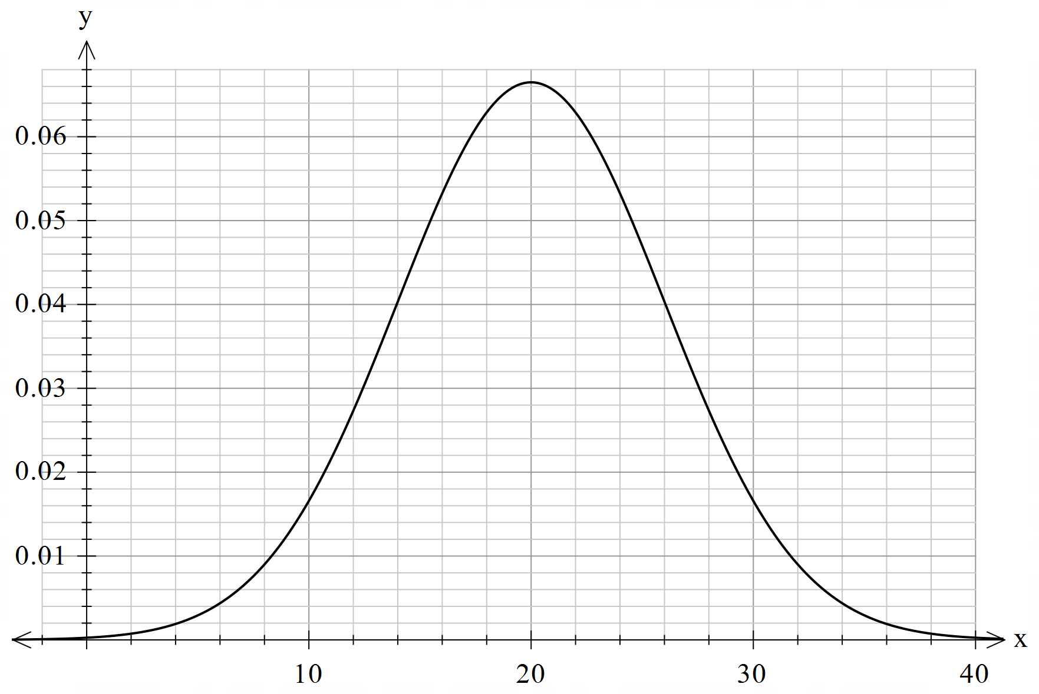
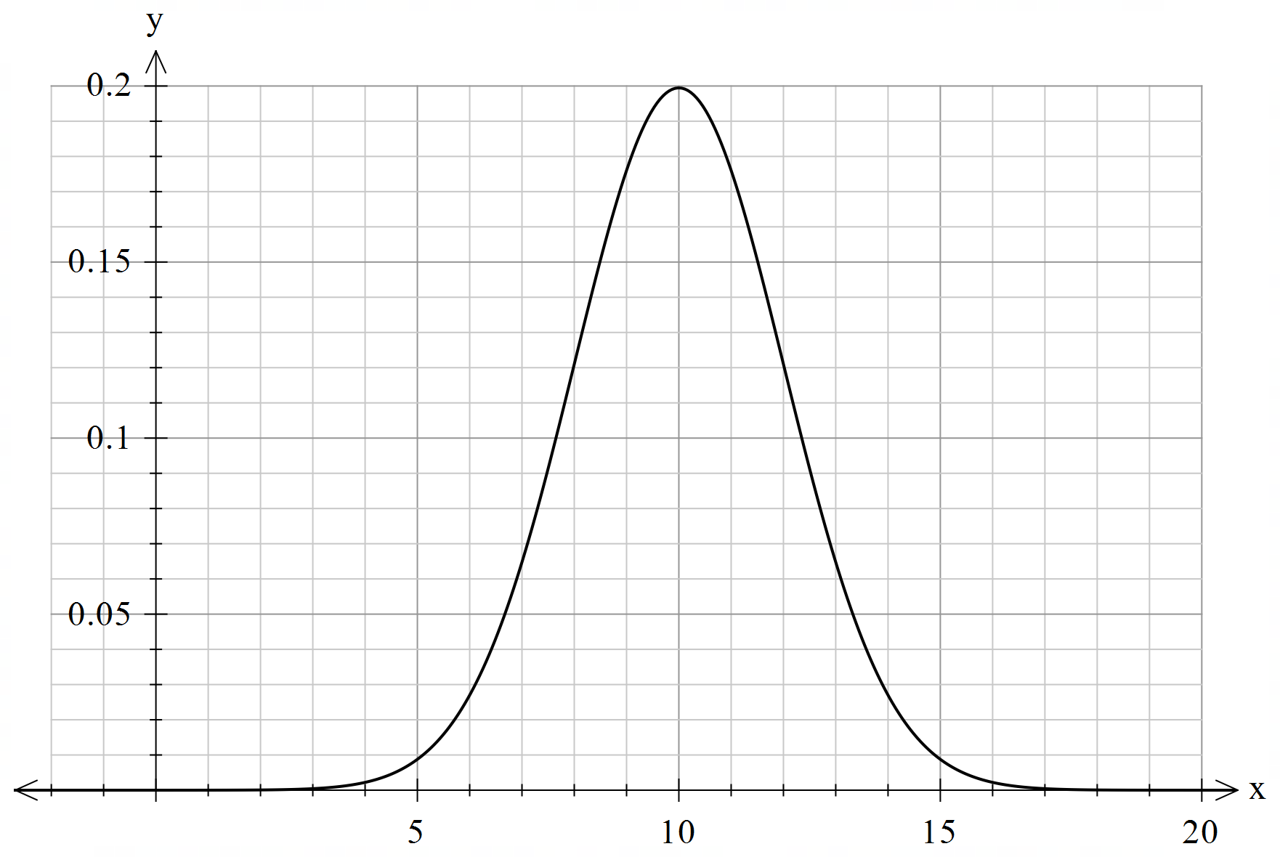
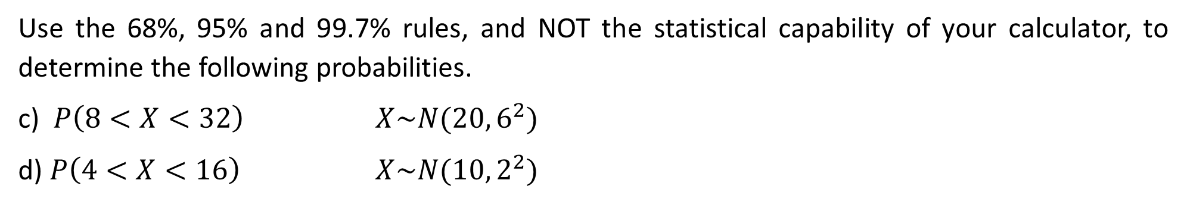
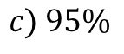
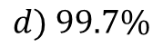
Guided Practice
Use the 68%, 95% and 99.7% rules, and NOT the statistical capability of your calculator, to determine the following probabilities.
c) $P\left(8<X<32\right)$ $X\sim N(20, 6^{2})$
d) $P\left(4<X<16\right)$ $X\sim N(10, 2^{2})$
$$d) 99.7\%$$
$$c) 95\%$$

Slide 20
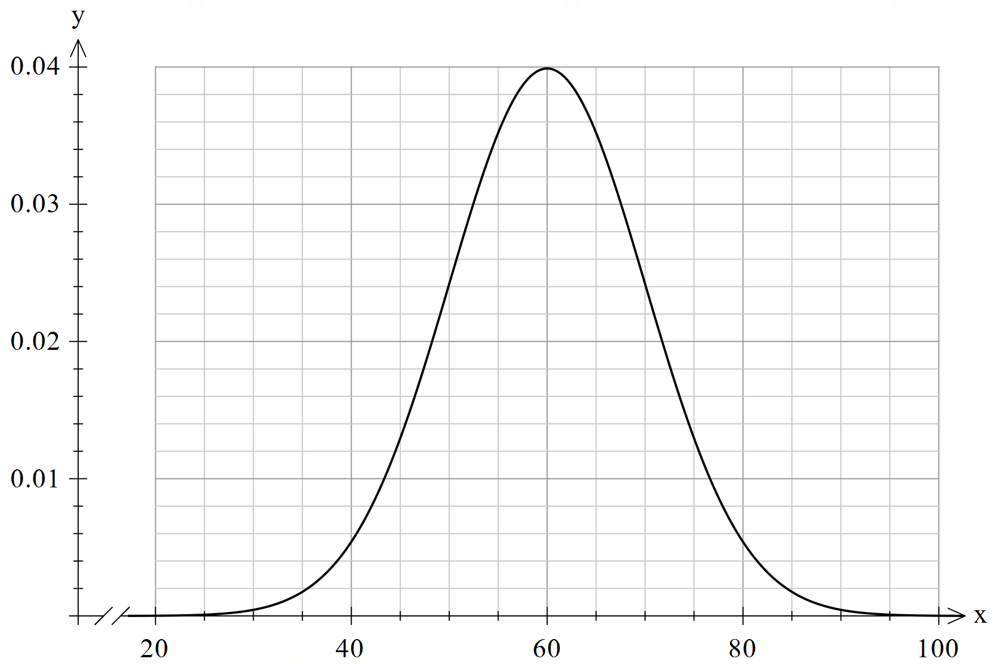
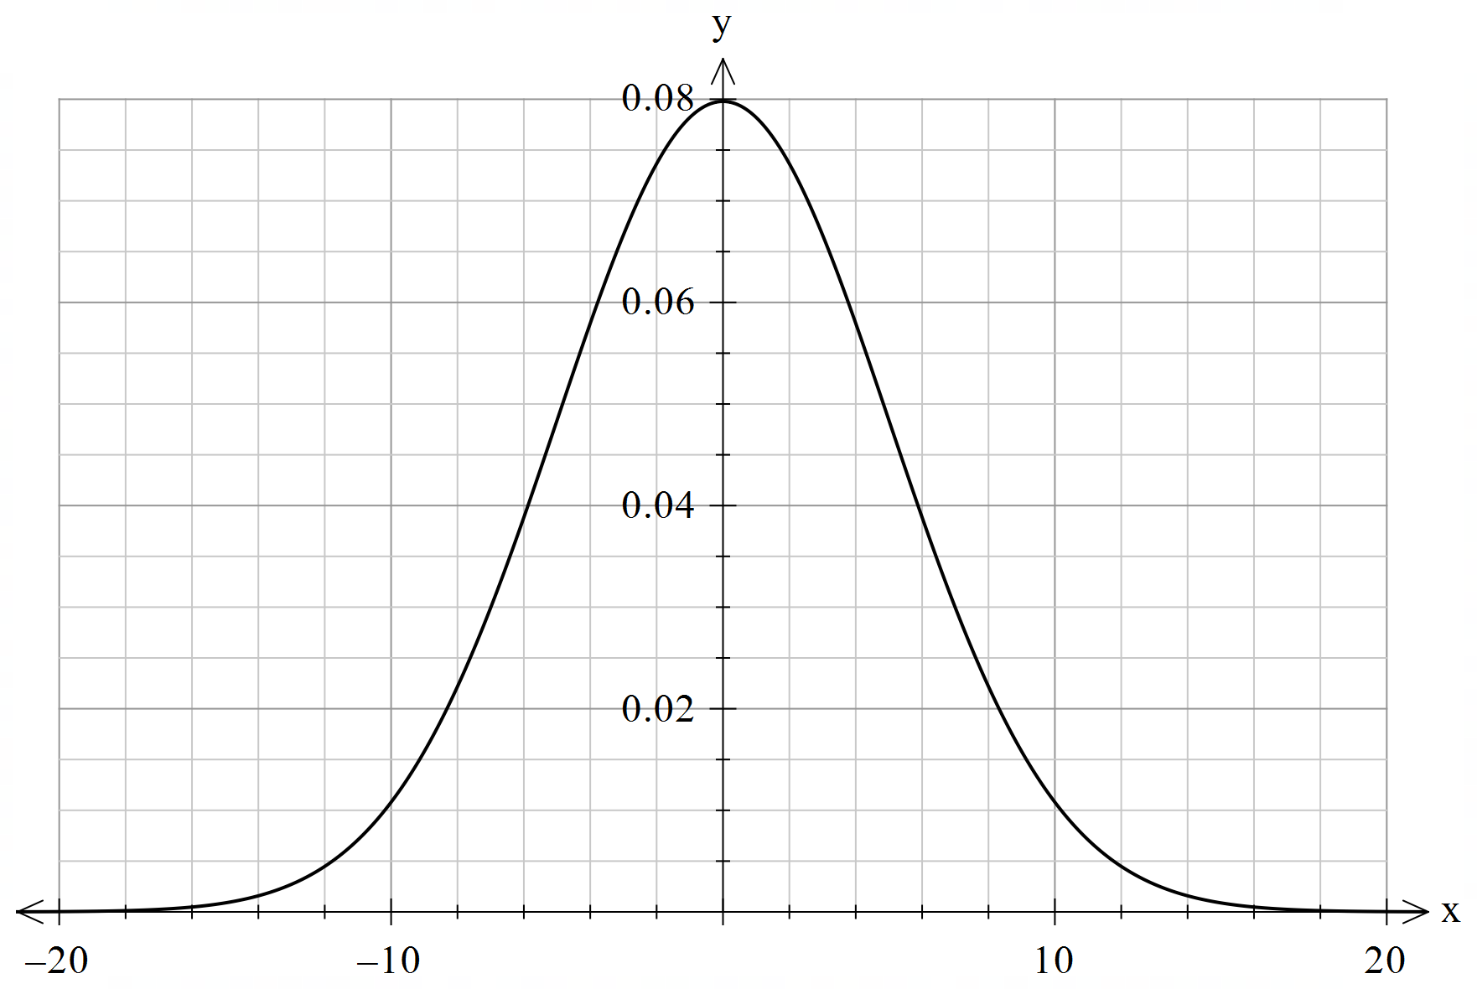


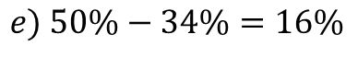
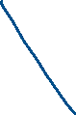

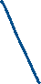


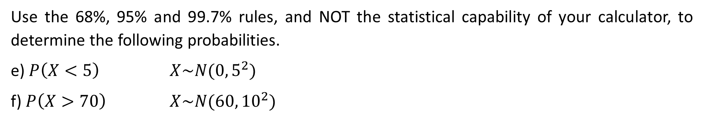
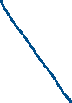

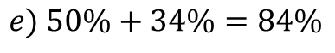
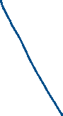

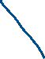
Guided Practice
Use the 68%, 95% and 99.7% rules, and NOT the statistical capability of your calculator, to determine the following probabilities.
e) $P\left(X<5\right)$ $X\sim N(0, 5^{2})$
f) $P\left(X>70\right)$ $X\sim N(60, {10}^{2})$
$$e) 50\%−34\%=16\%$$
$$e) 50\%+34\%=84\%$$

Slide 21
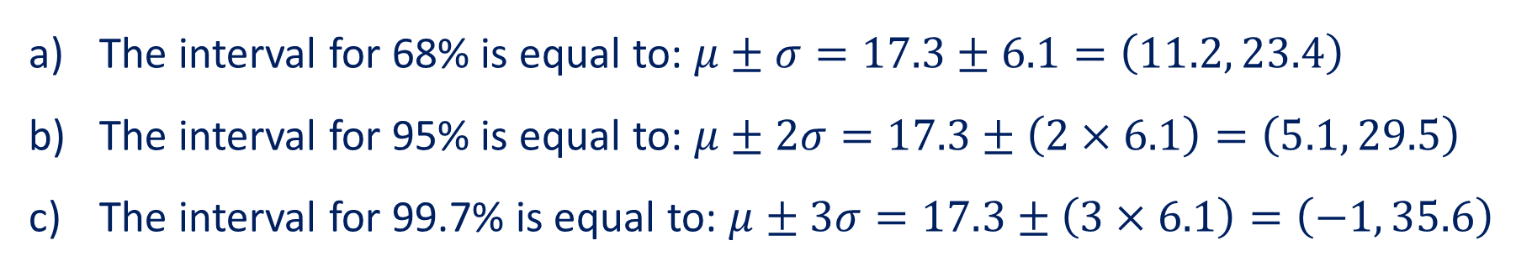
Guided Practice
A distribution where μ = 17.3 and σ = 6.1 has an approximately normal distribution. Find the interval in which you would expect to find the following percentages of results:
68% of results
95% of results
99.7% of results
68% = 1 standard deviation above and below the mean.
95% = 2 standard deviations above and below the mean.
99.7% = 3 standard deviations above and below the mean.
The interval for 68% is equal to: $μ±σ=17.3±6.1=\left(11.2, 23.4\right)$
The interval for 95% is equal to: $μ±2σ=17.3±\left(2×6.1\right)=\left(5.1, 29.5\right)$
The interval for 99.7% is equal to: $μ±3σ=17.3±\left(3×6.1\right)=\left(−1, 35.6\right)$

Slide 22
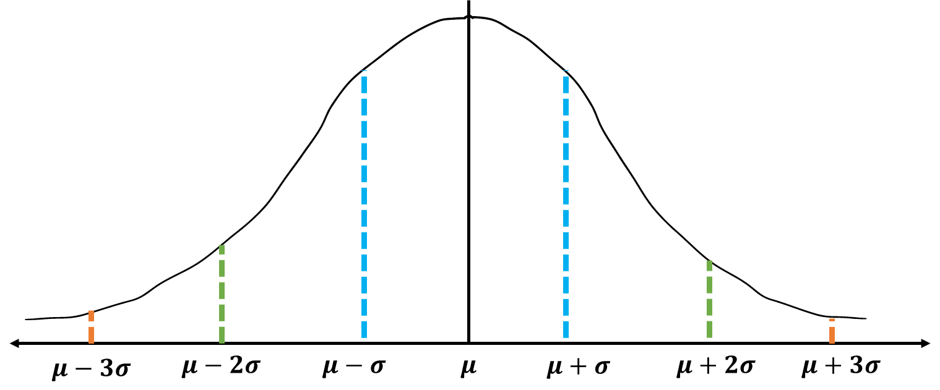
Guided Practice
The weight of a group of dogs in a kennel are normally distributed. A puppy named Duke is selected from the kennel, and is found to have a standardised weight (z-score) of +2.
Where does Duke’s weight sit in terms of the standard deviation from the mean?
Approximately what percentage of dogs are lighter than Duke?
If there are 400 dogs in the kennel, how many are lighter than Duke?
If he has a z-score of +2, this means he is sitting 2 standard deviations above the mean weight.
Since Duke’s weight is 2 standard deviations above the mean, he has the following percentage of dogs that are lighter than him:
50% + 47.5% =97.5%
97.5% of 400 = 390 dogs. There are 390 dogs lighter than Duke.

Slide 23
Independent Practice
Complete Cambridge Ex 11B

